Slide 1
Southwestern Washington English
What We Know So Far
I
I
I
Joey Stanley
University of Georgia
joeystan@uga.edu
Tiny Talks
February 18, 2016

Slide 2
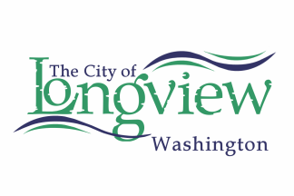
Introduction 2

Slide 3
The West

Slide 4
Labov, Ash, & Boberg (2006)
Washington 4

Slide 5
English in the West
The West (Labov, Ash, & Boberg 2006)
“low homogeneity” in phonological inventory
relatively recently settled
Pacific Northwest
“Massively understudied” compared to other regions (McLarty et al 2014)
“[It] forms a relatively coherent dialect area and is centered on the Portland district.” (Wolfrum & Schilling-Estes 2008:123)
Younger generation is developing a unified variety. (Conn 2006)
Washington 5

Slide 6
English in Washington & Oregon
Washington
Monophothonged /e/ as in “bake” (Wassink, et. al. 2009)
Cot-caught merger (Wassink 2015)
Oregon
“Anne” sounds like “Ian” (Conn 2006)
past habitual “used to go” not used as much as “would go” or “went” (McLarty et al 2014)
Fronted /u/ and /o/ like Northern California (Ward 2003, McLarty & Kendall 2014)
Basically a mix of Washington and California (Becker at. al 2013)
Washington 6

Slide 7
English in Washington & Oregon
“Bacon and Eggs” Merger
Merger of /eɡ/ and /ɛɡ/
Even open syllables (leggings)
Not before /k/, but especially /ŋ/ (Wassink & Riebold 2013)
Not a big deal (Wassink 2014)
Exhaustive list of /eɡ/ words: bagel, vague, plague, pagan, the Hague
no homophones are created, no distinction lost
More common in casual styles (Wassink, et. al. 2009)
Nearly merged in perception as well (Freeman 2015)
Not in Nevada English (Gunter et. al. 2016)
Raising of /æɡ/ (bag)
Common in Wisconsin, Minnesota, W. Canada
However, some in WA merge /æg/ as well (Wassink & Riebold 2013)
But duration may help distinguish still (Freeman 2014)
/ɛɡ/ is longer than /eɡ/and /æg/
Washington 7
Notes:
“rake”/“wreck” or “bacon”/“beckon”

Slide 8
Longview

Slide 9
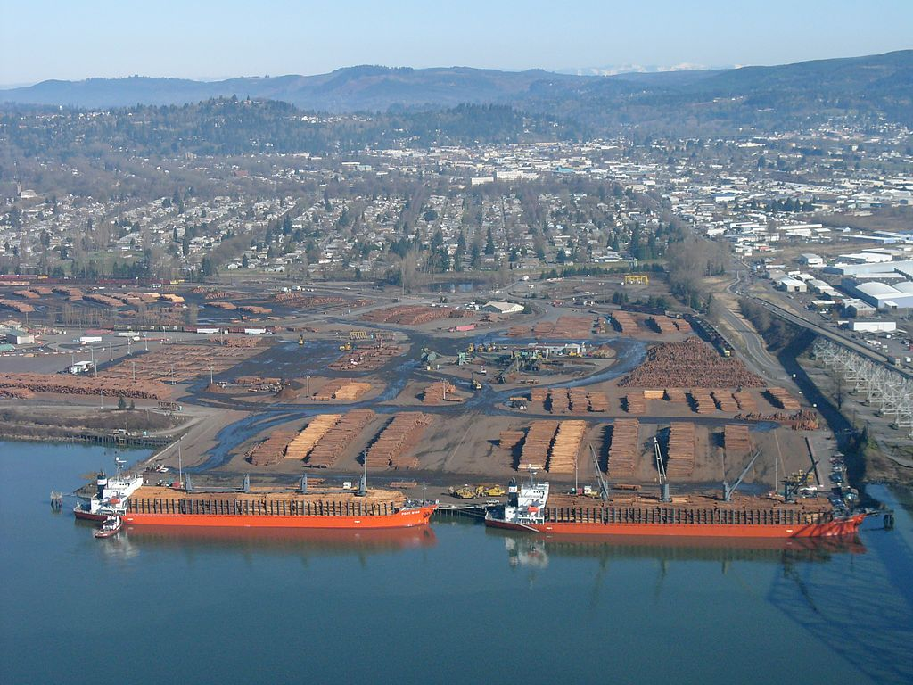
Longview 9

Slide 10
Founder Effect
“The durable imprint of language structures brought to an area by the earliest groups of people forging a new society in the regions.”
Wolfram & Schilling-Estes 2008:30
Longview 10

Slide 11
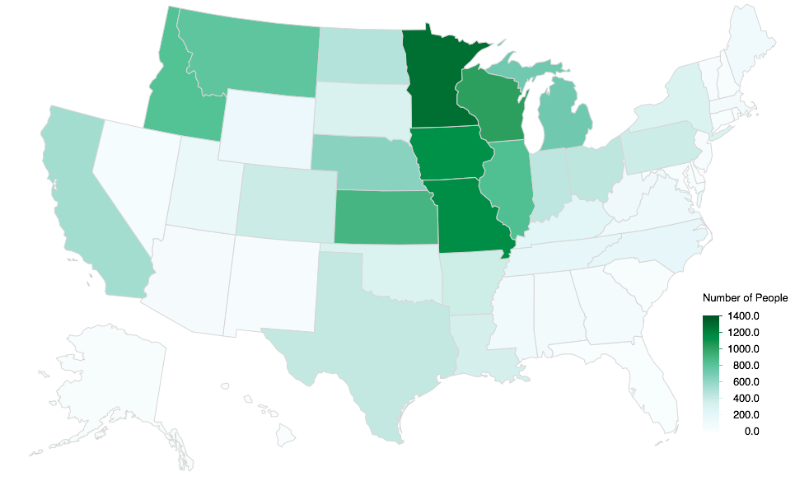
Birth state of Longview residents from the 1930 census
Longview 11

Slide 12
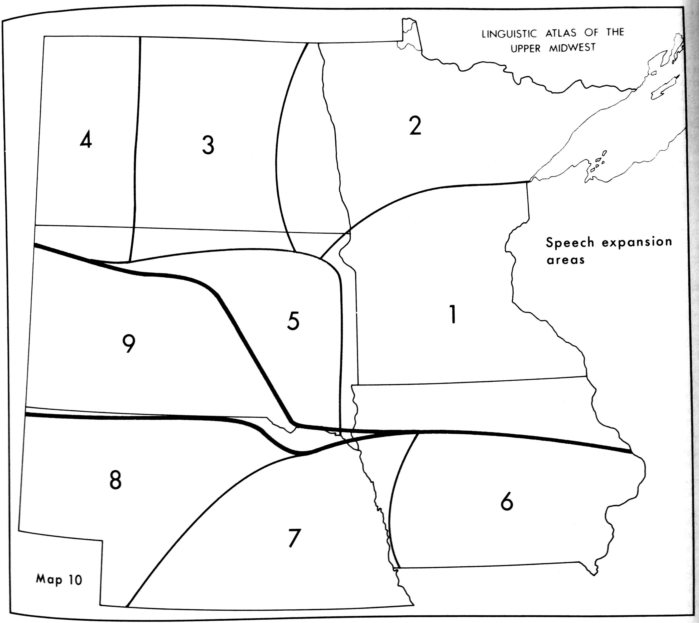
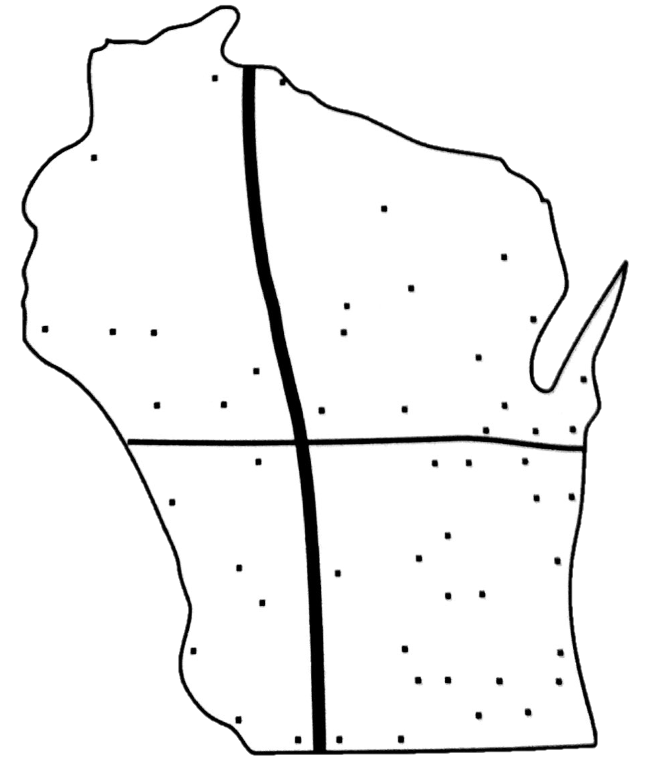
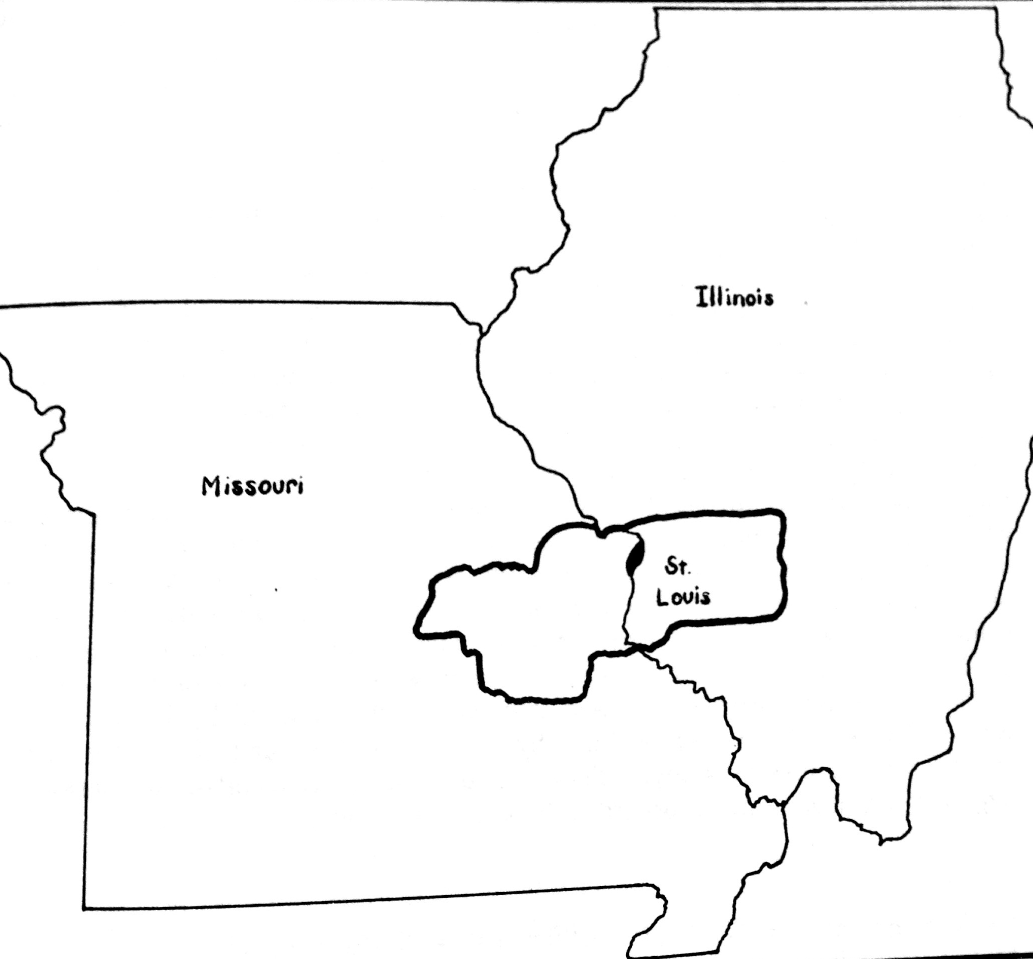
Early 20th Century Midwest English (Allen 1976)
Shared Features
Bacon & Eggs merger
Monophthongized /e, o/
hence “Minnes[o]ta”
Differing Features
cot ≠ caught
c[a]t vs. c[ɔ]ght
hoarse ≠ horse
h[o]rse vs. h[ɔ]rse
Mary ≠ merry ≠ marry
m[e]ry, m[ɛ]rry, m[æ]rry
wine ≠ whine
[w]ine vs. [ʍ]ine
(Frankenstein dialect map pieced together from Allen 1976:125, Murray 1986:211, and Carver 1993:213 )
Midwest 12

Slide 13
Hypothesis
Most Longview residents sound Western, but due to the Founder Effect, the mill workers sound like early 20th century Midwestern.
13

Slide 14
References
Allen, Harold B. 1976. The Linguistic Atlas of the Upper Midwest. 3 Vols. Minneapolis, MN: University of Minnesota Press.
Becker, Kara, Anna Aden, Katelyn Best, Rena Dimes, Juan Flores & Haley Jacobson. 2013. Keep Portland weird: Vowels in Oregon English. New Ways of Analyzing Variation (NWAV) 42. Pittsburgh.
Carver, Craig M. 1993. Regional Speech Variation in Wisconsin. In Timothy C. Frazer (ed.), “Heartland” English: Variation and Transition in the American Midwest, 199–214. Tuscaloosa: University of Alabama Press.
Conn, Jeff. 2006. Dialects in the Mist (Portland, OR). In Walt Wolfram & Ben Ward (eds.), American Voices: How Dialects Differ from Coast to Coast, 149–155. Malden, MA: Blackwell Publishing.
Freeman, Valerie. 2014. Bag, beg, bagel: Prevelar raising and merger in Seattle Caucasians. New Ways of Analyzing Variation (NWAV 43). Chicago.
Freeman, Valerie. 2015. Perceptual distribution of merging phonemes. Proceedings of the Annual Meeting of the Berkeley Linguistics Society (BLS 41). Berkeley.
Gunter, Kaylynn, Ian Clayton & Valerie Fridland. 2016. Lɛg Raising in Nevada. Paper presented at the American Dialect Society, Washington D.C.
Labov, William, Sharon Ash & Charles Boberg. 2006. The atlas of North American English: Phonetics, phonology and sound change. Walter de Gruyter.
McLarty, Jason, Charlie Farrington & Tyler Kendall. 2014. Perhaps we used to, but we don’t anymore: The Habitual Past in Oregonian English. University of Pennsylvania Working Papers in Linguistics 20(2). 13.
McLarty, Jason & Tyler Kendall. 2014. The relationship between the high and mid back vowels in Oregonian English. New Ways of Analyzing Variation 43. 23–26.
Murray, Thomas E. 1986. The Language of St. Louis, Missouri: Variation in the Gateway City. (American University Studies: Series XIII Linguistics 4). New York: Peter Lang Publishing Inc.
Ward, Michael. 2003. Portland Dialect Study: The Fronting of /ow, u, uw/ in Portland, Oregon. Portland, Oregon: Portland State University Master’s Thesis.
Wassink, Alicia Beckford, Robert Squizzero, Mike Scanlon, Rachel Schirra & Jeff Conn. 2009. Effects of Style and Gender on Fronting and Raising of /æ/, /e:/ and /ε/ before /g/ in Seattle English. New Ways of Analyzing Variation (NWAV) 38.
Wassink, Alicia Beckford & John Matthew Riebold. 2013. Individual Variation and Linguistic Innovation in the American Pacific Northwest. Workship. Paper presented at the Sound Change Actuation at the Chicago Linguistic Society’s 49th annual meeting, Chicago.
Wassink, Alicia. 2014. Vowel raising in Washington English: What’s the BAG deal? Cascadia Workshop in Sociolinguistics 1. (11 February, 2016).
Wassink, Alicia Beckford. 2015. Sociolinguistic Patterns in Seattle English. Language Variation and Change 27(01). 31–58. doi:10.1017/S0954394514000234.
Wolfram, Walt & Natalie Shilling-Estes. 2006. American English: Dialects and Variation. 2nd ed. (Language in Society). Blackwell.
Zelinsky, Wilbur. 1973. The cultural geography of the United States. (Foundations of Cultural Geography Series.). Prentice-Hall.

